Slide 1


Group 1

Slide 2

HOW TO HELP CONESTOGA
RECRUIT MORE
INTERNATIONAL STUDENTS ?

Slide 3
Executive Summary
In 2020-2021, a total of 17,649 international students studied at Conestoga College. And the number kept increasing between 2012-2021. Here are some key insights:
What can we do?
Benchmark study with Seneca College.
Market campaign in PHILIPPINES, CHINA, VIET NAM, KOREA SOUTH, PAKISTAN, UNITED STATES, JAMAICA, NIGERIA, and IRAN.
Share more valuable content that is concern by 18-24 years old students
Popular programs are the starting point of marketing.
Compared with 2017-2018, International students increased by 41%
48% were international students at Conestoga College in 2021
Conestoga College is the No.2 college in 2021 based on the new international student number.
235 programs in 2021
7 Campuses in 2021
Top 3 countries: India (72%), China (3%), South Korea (2%)
Most of the students’ age range is 18-29 years old

Slide 4
Analysis approach
The problem: Understand the problem statement – “How to help Conestoga recruit more international students?”
Prepare the data: Got clarity of the dataset, performed data cleaning (filter data, delete useless data and adjust the data table format) and exploratory data analysis using Excel and Tableau.
Deep Dive: Prepped data and carried out time series analysis on international students at different colleges. Analysis of international students at the top 6 colleges from different countries. Compare students’ demographics, programs and credentials in Conestoga.
Insights: Results were presented in a dashboard using Tableau to allow stakeholders to interact with the data and get more insights
Recommendations: Provided recommendations based on insights obtained from the deep dive for implementation.

Slide 5
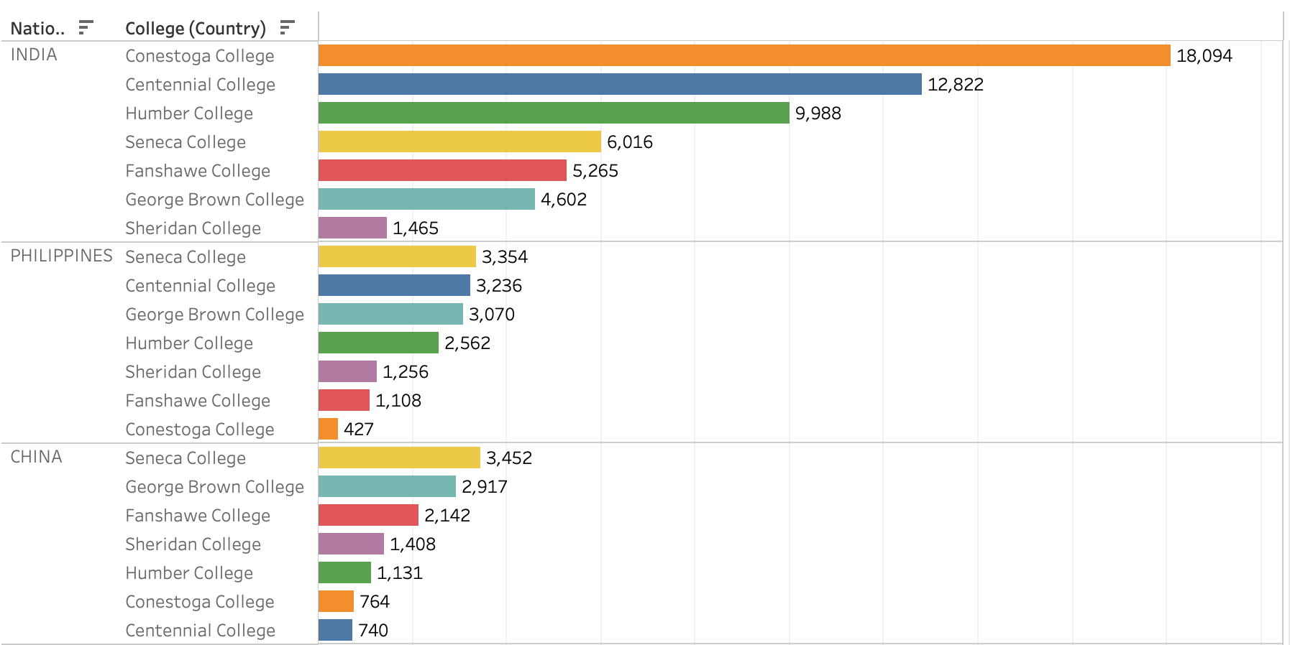
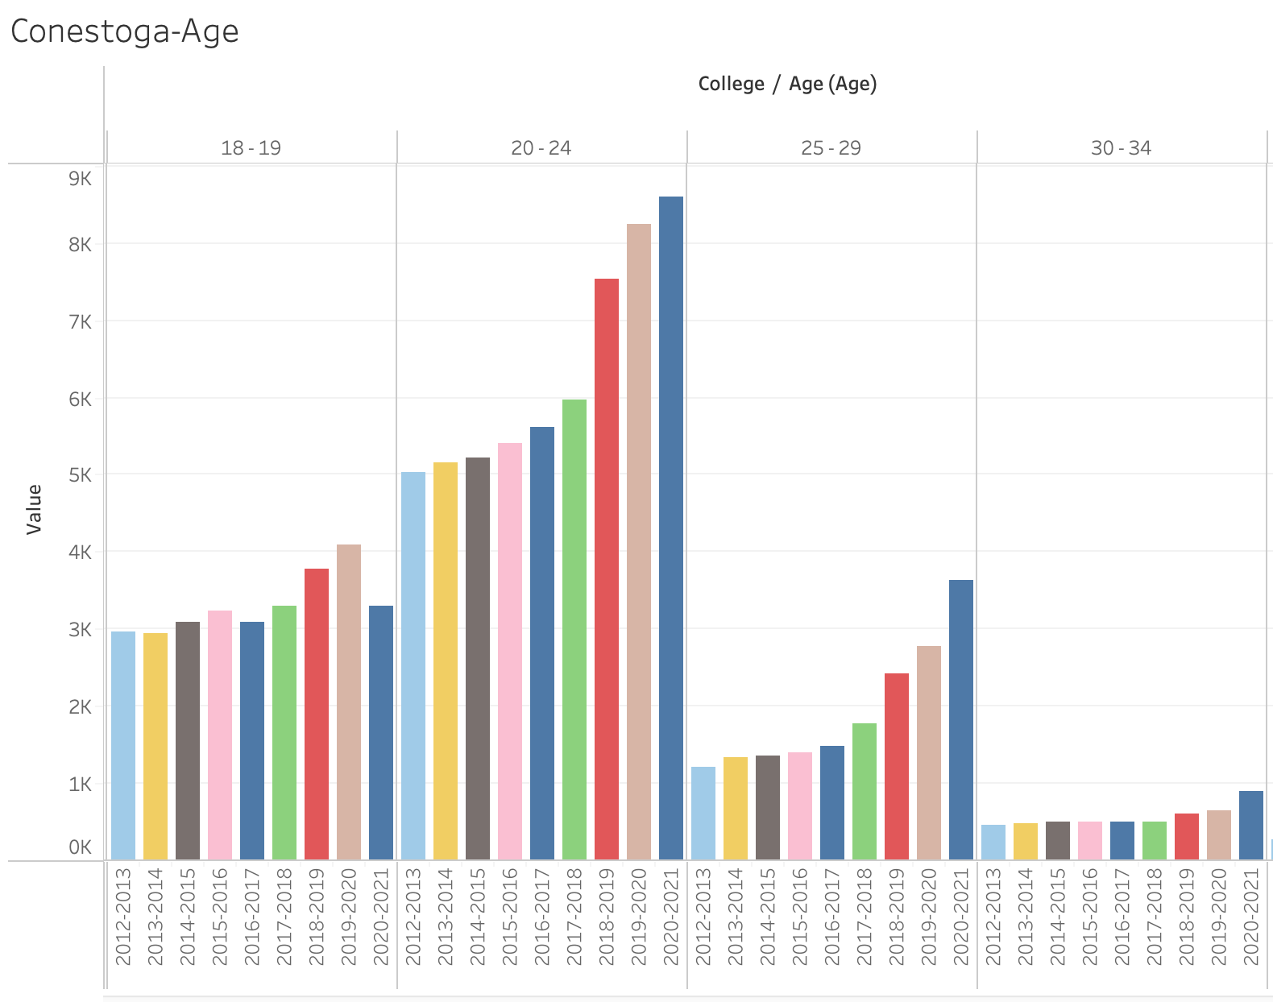
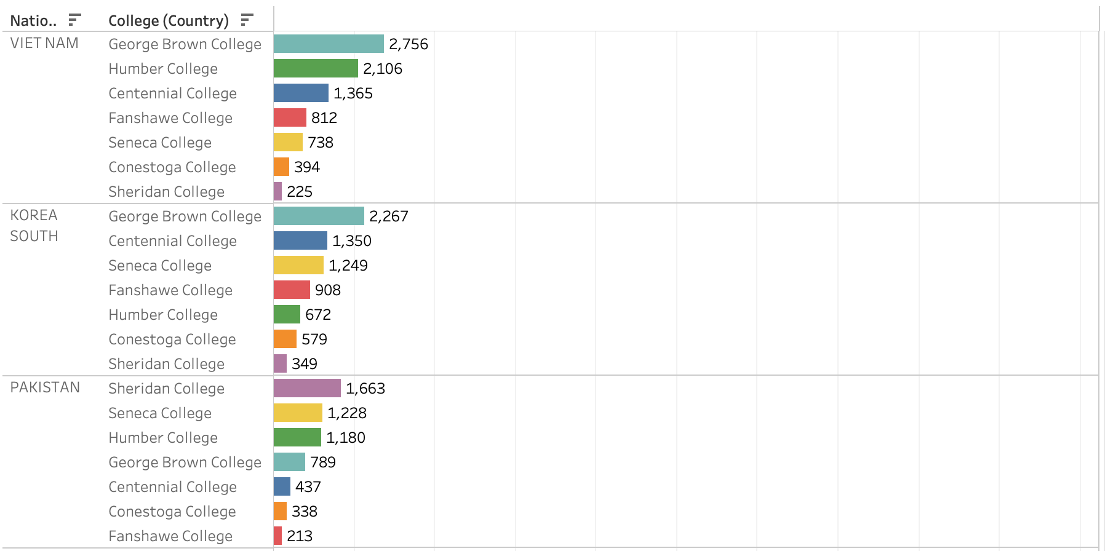
Key Insight:
Interpretation of results
Compared with other countries, Conestoga College had good success in India Market (No.1).
But compared with other colleges, Conestoga College recruits significantly fewer students in the other top market. It is only 12.7% of Seneca in the PHILIPPINES, 21.6% of Seneca in CHINA, and 14.3% of George Brown College in VIET NAM.
Less 18-19 years old students in 2021, and 20-24 years old students’ growth rate will slow down.

Slide 6
Recommendations
Based on the analysis carried out, below are a few recommendations for Conestoga College to consider implementing:
Short Term
Long Term
Benchmark study with Seneca College to learn some good practices in international marketing.
Digital Marketing –
Based on customer research in a different country, select different sale points.
Create more valuable content and promote it on social media
Recruit more social media ambassadors and student ambassadors to interview more international students to share their study experience at Conestoga and their working status after graduation in Waterloo Region.
Improve education quality and student service, and build word-of-mouth.
Invest paid advertising in the top market: PHILIPPINES, CHINA, VIET NAM, KOREA SOUTH, PAKISTAN, UNITED STATES, JAMAICA, NIGERIA, IRAN
Cooperate with more agents to recruit international students

Slide 7

APPENDIX

Slide 8
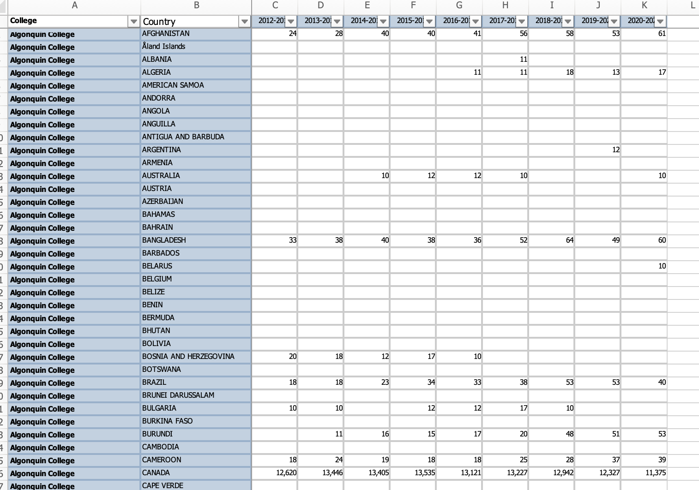
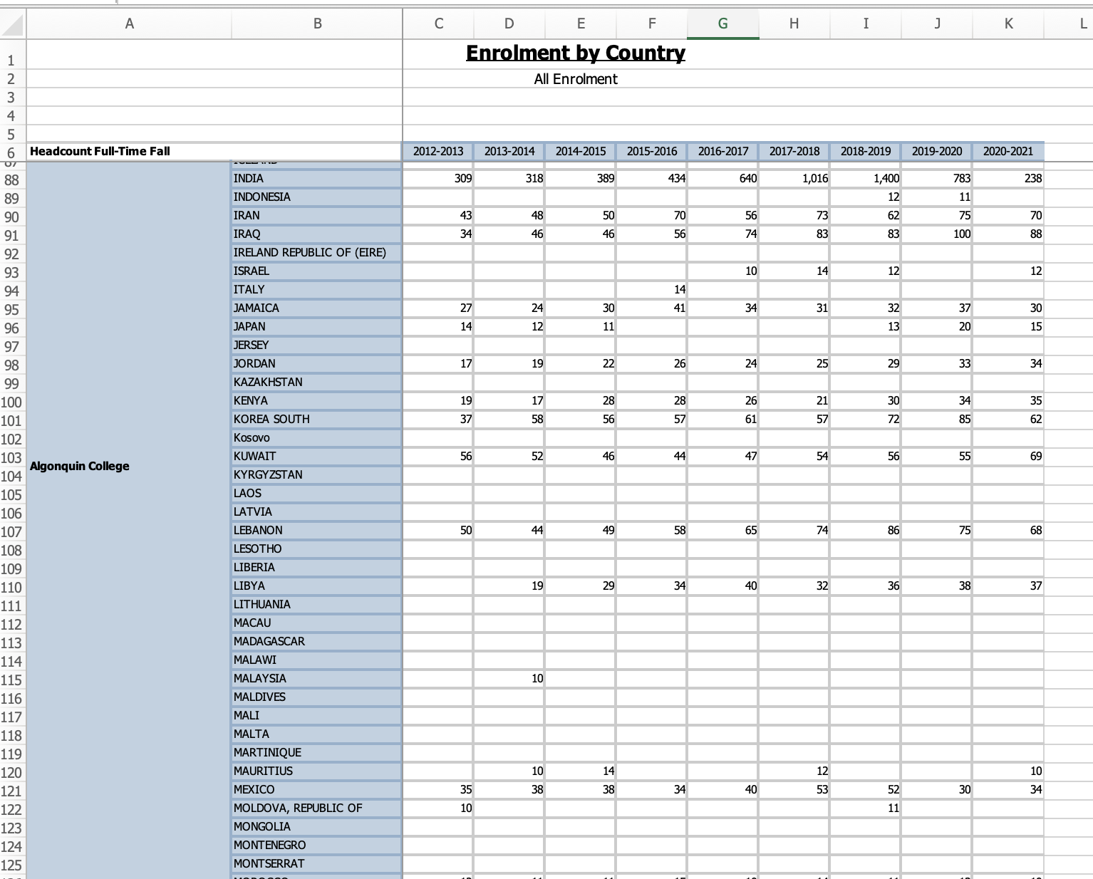
Data Cleaning(filter data, delete useless data and adjust the format of the data table)

Slide 9
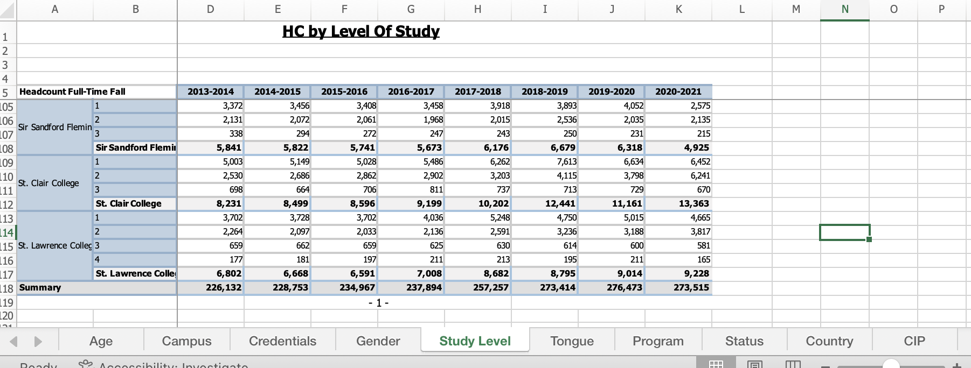
Data Cleaning(filter data, delete useless data and adjust the format of the data table)
According to the problem statement, determine what data are useful in analysis, what data are useless.

Slide 10
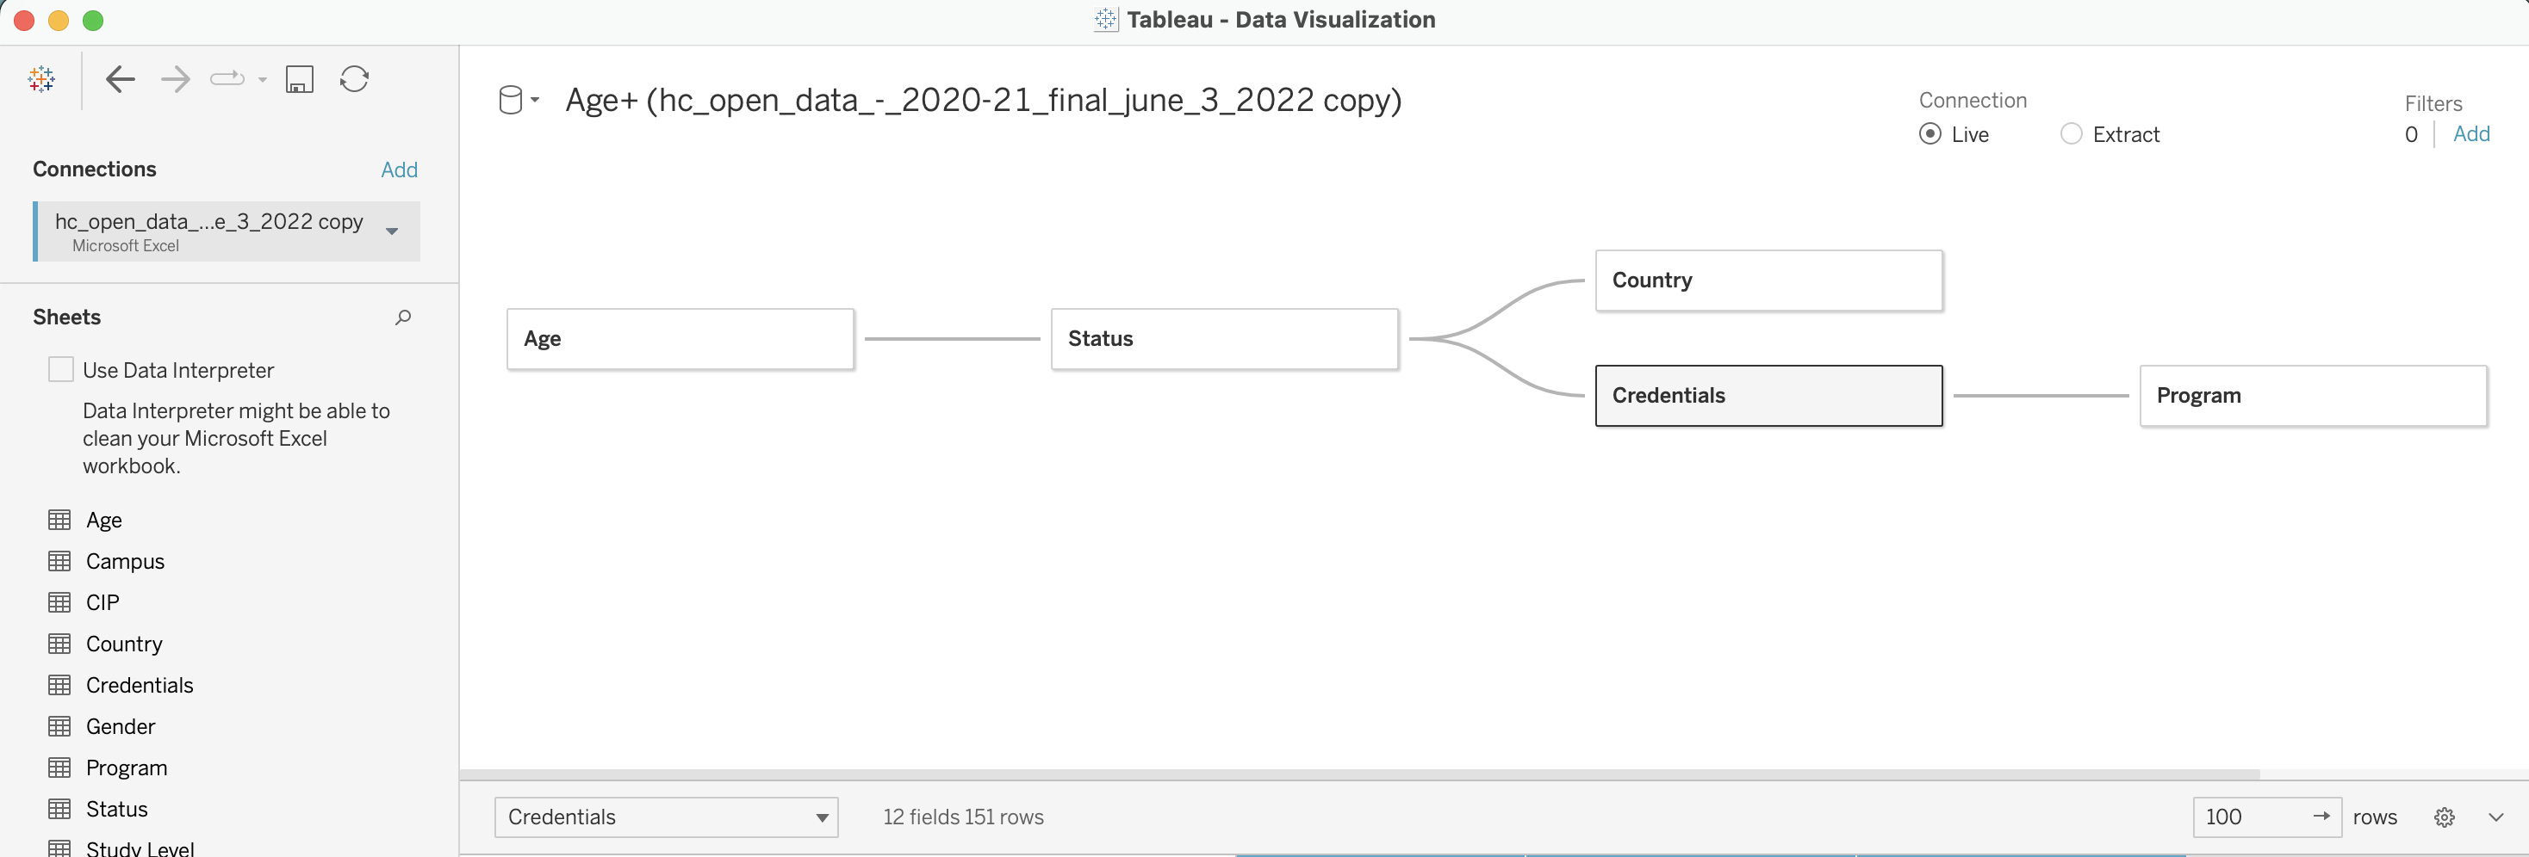
Connect data source (Excel) with Tableau

Slide 11
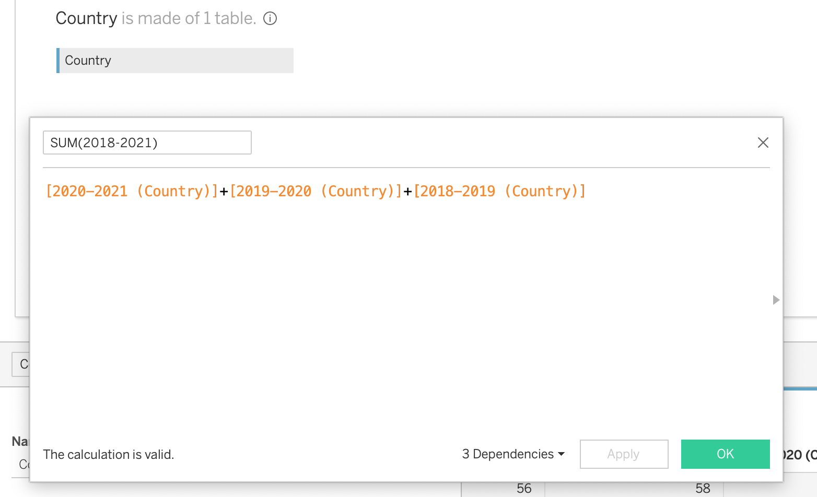
Add calculation column in Tableau based on need

Slide 12
Data Analysis (Don’t need put in final PPT)
All students in colleges
All students are international students
Conestoga College’s international students
Nationality of All Colleges—where is the main market?
Conestoga students’ nationality analysis- where can Conestoga do better?
Age analysis and Program Credential analysis – Who are the main future students
Conestoga students’ demographics analysis

Slide 13
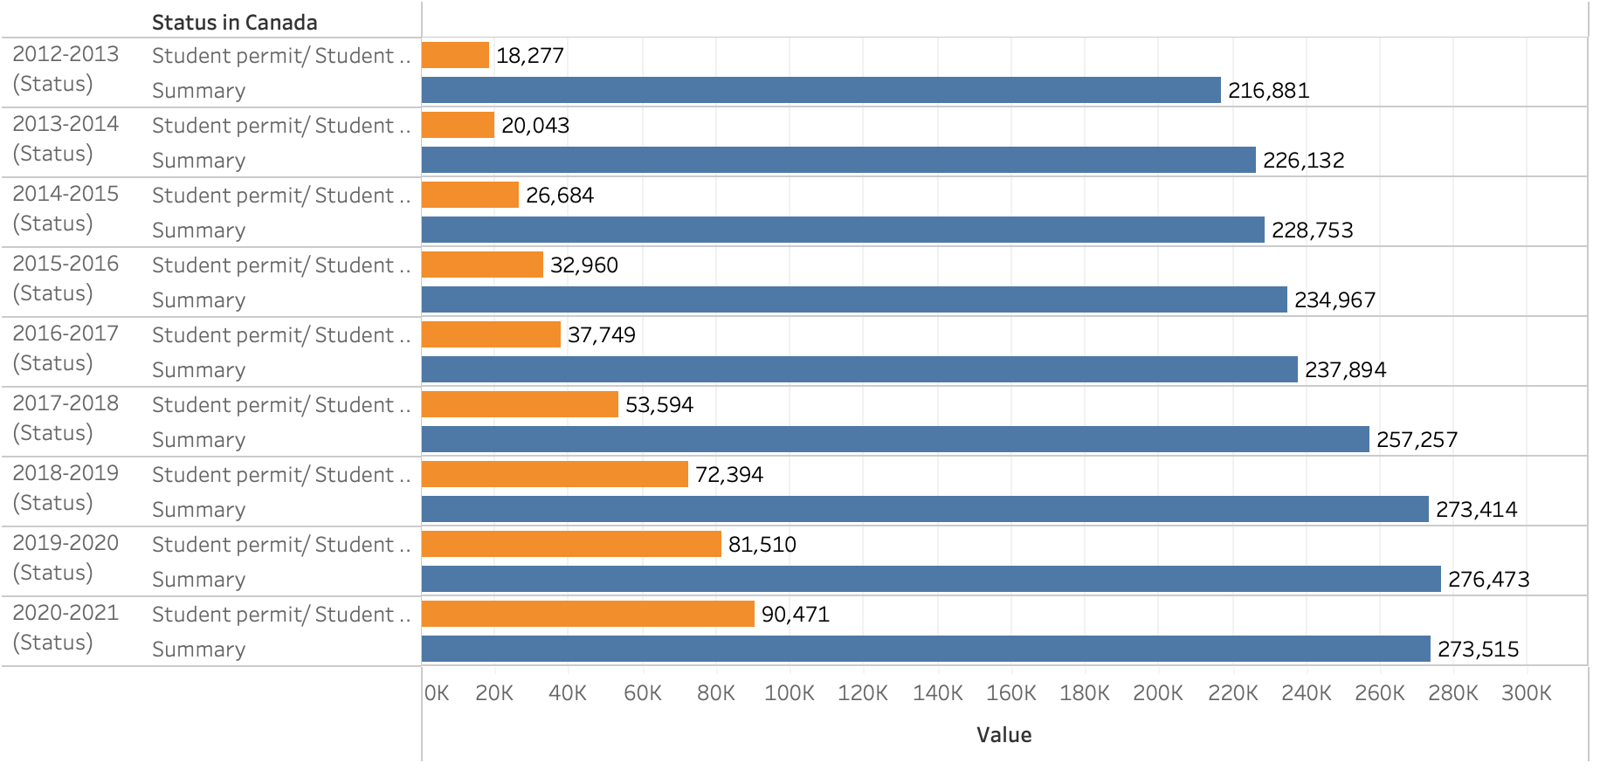
From 2012-2021, International Students number increased in every year.

Slide 14
In the last 9 years, the number of international students increased mostly in Conestoga and Seneca, and Centennial’s decreased mostly.

Slide 15
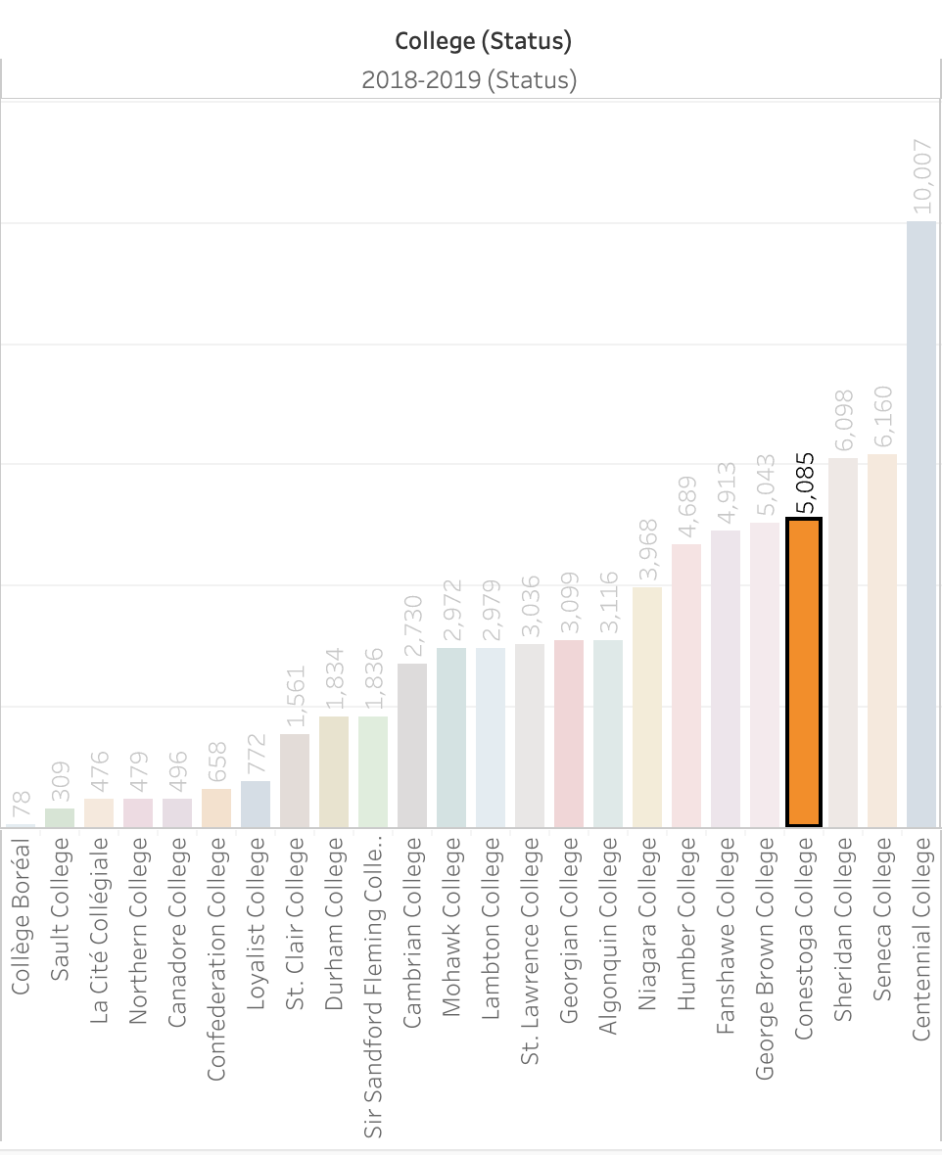
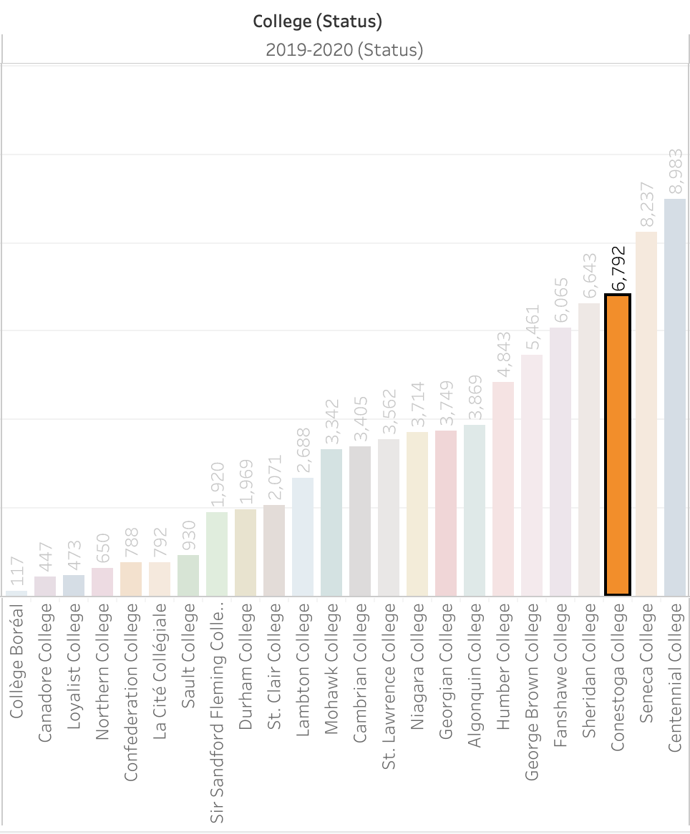
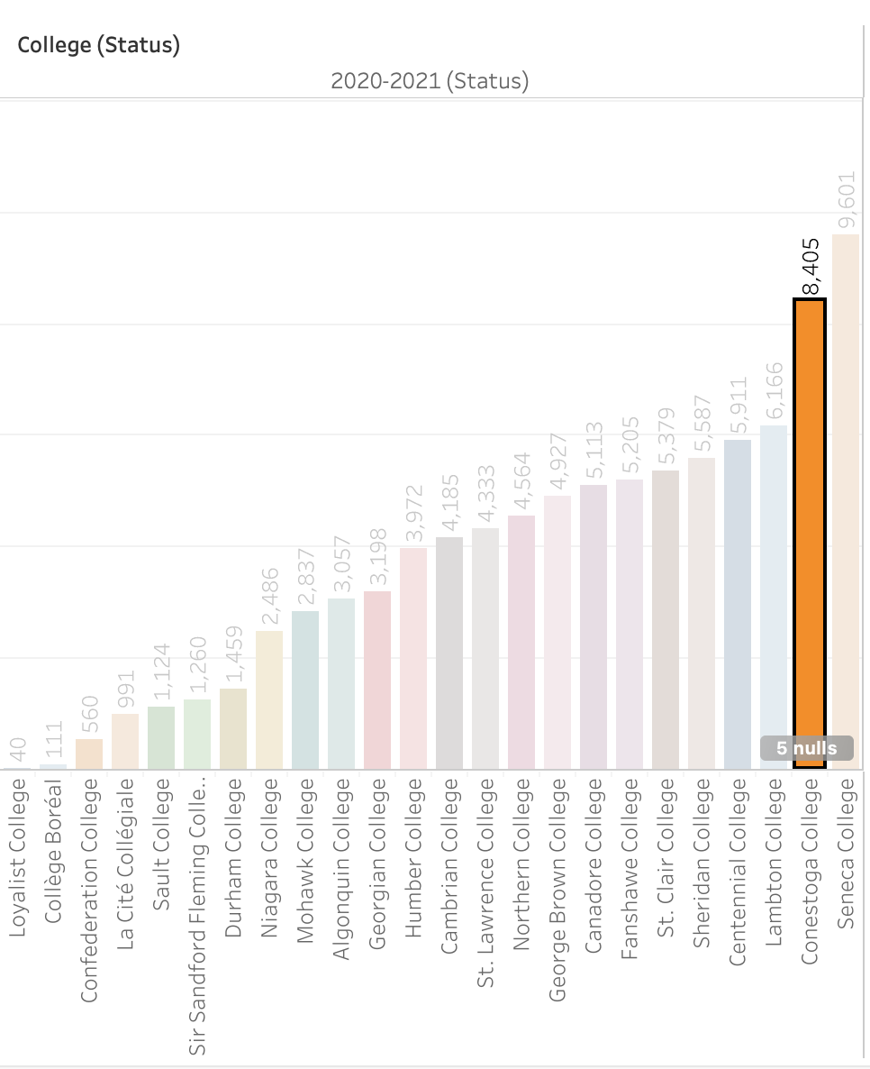
Between 2018-2021, According to the ranking of the number of international students, Conestoga has improved from 4th to 2nd. Seneca College is the benchmark in Canada Education Area.

Slide 16
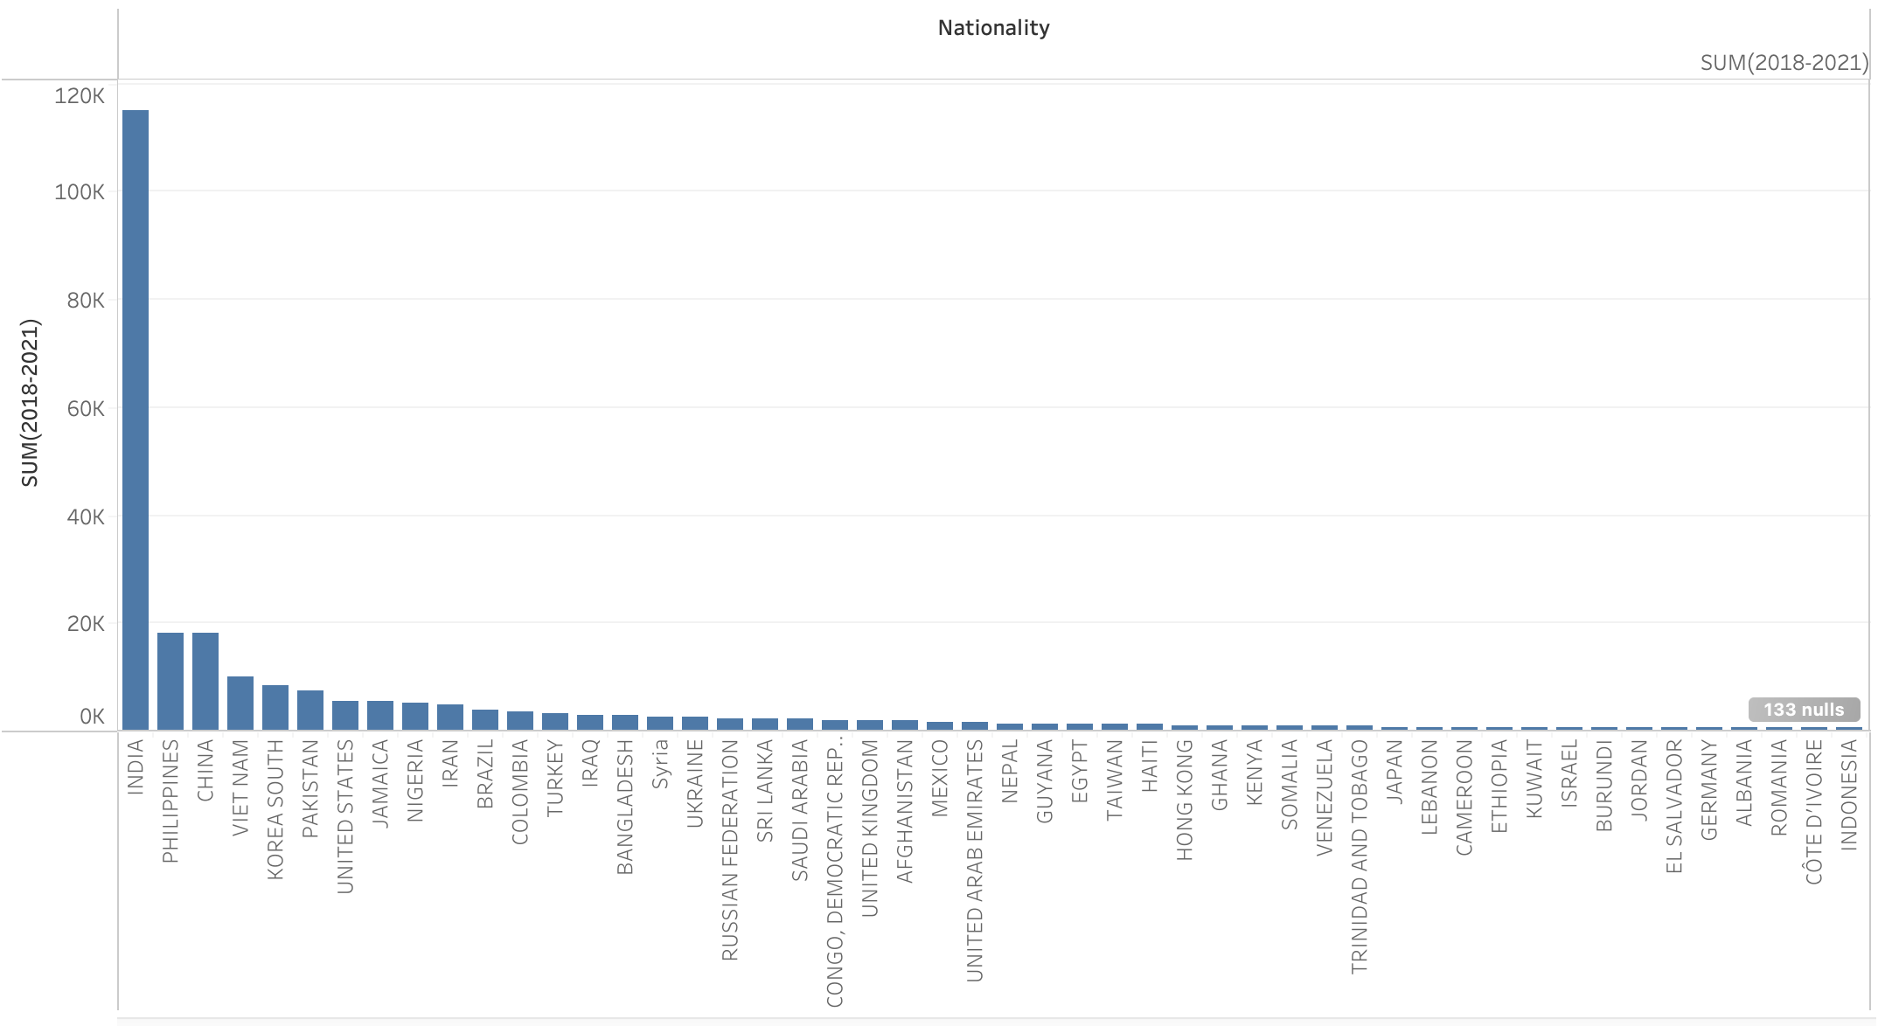
According to the total amount in 2018-2021, the top 10 market are INDIA, PHILIPPINES, CHINA, VIET NAM, KOREA SOUTH, PAKISTAN, UNITED STATES, JAMAICA, NIGERIA, IRAN.

Slide 17
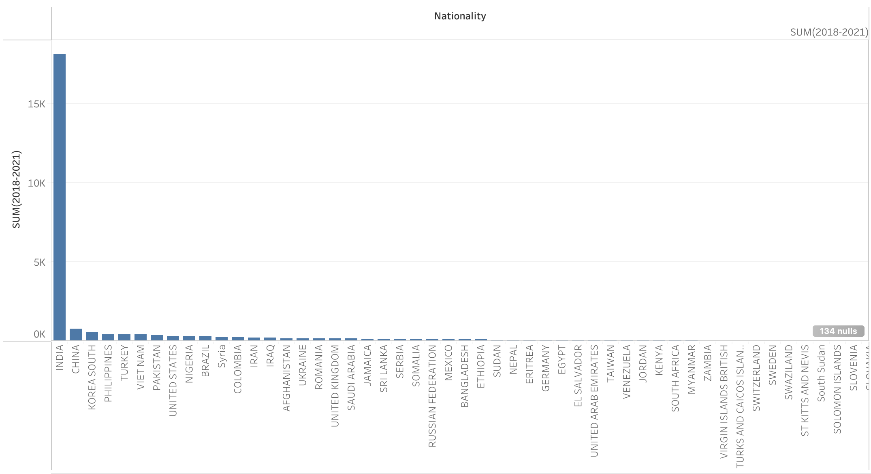
According to the total amount in 2018-2021, the top 10 market for Conestoga College are: INDIA, CHINA, KOREA SOUTH, PHILIPPINES, TURKEY, VIET NAM, PAKISTAN, UNITED STATES, NIGERIA, BRAZIL

Slide 18
Compare the student from top 10 market to Conestoga and other 6 colleges: Centennial, Fanshawe, George Brown, Humber, Seneca, Sheridan

Slide 19
Compare the student from top 10 market to Conestoga and other 6 colleges: Centennial, Fanshawe, George Brown, Humber, Seneca, Sheridan

Slide 20
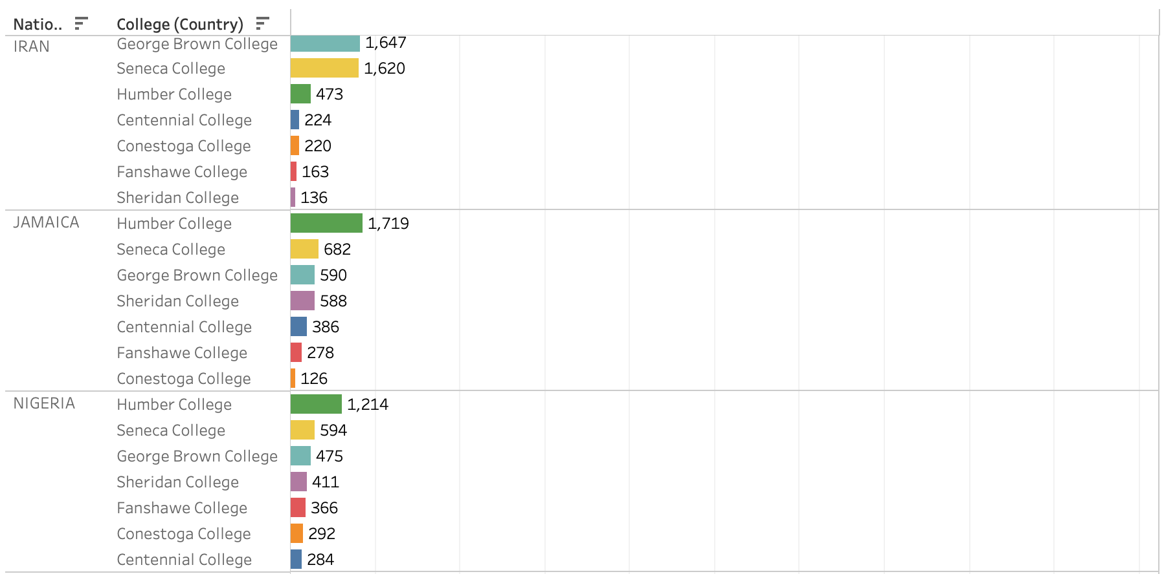
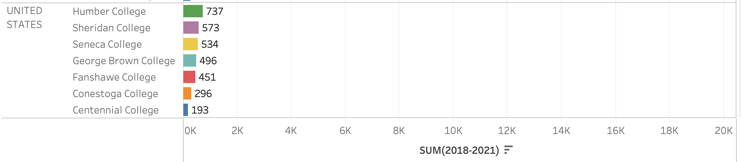
Compare the student from top 10 market to Conestoga and other 6 colleges: Centennial, Fanshawe, George Brown, Humber, Seneca, Sheridan

Slide 21
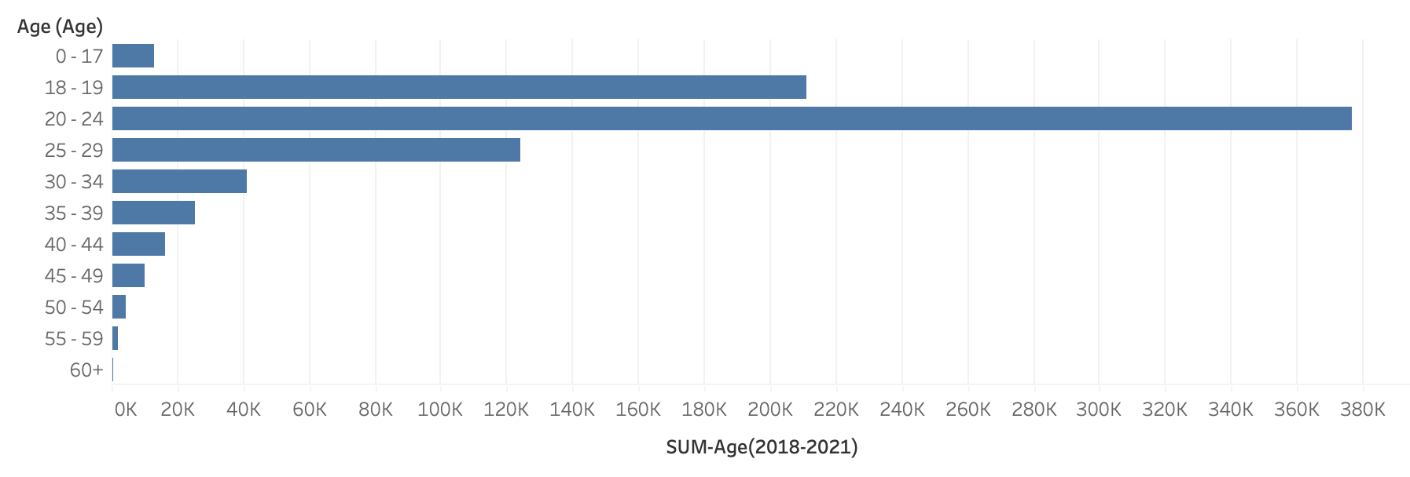
The main age range of student who study in college is 18-29

Slide 22
The students who are 18-19 years old has decreased recently, and 20-24 years old students increased slower.

Slide 23
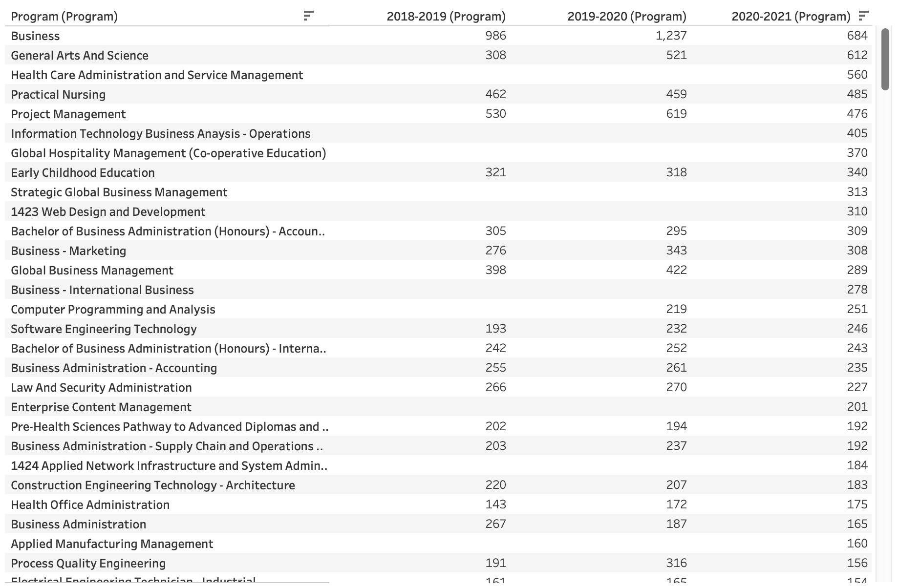
Based on the student number in 2020-2021, blow are most popular programs in Conestoga College

Slide 24
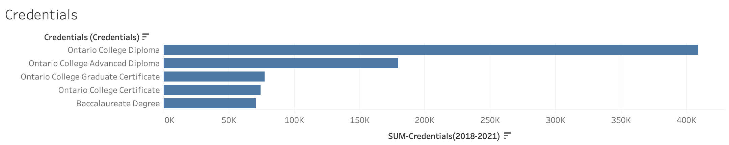
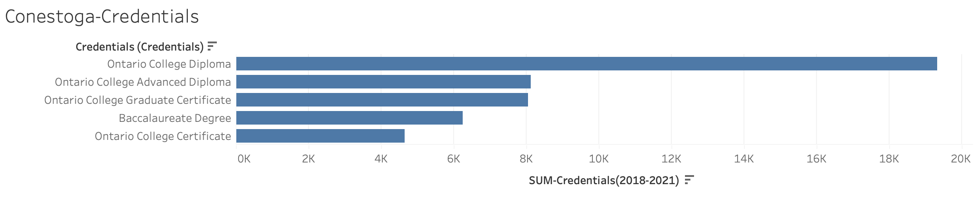
Credentials Analysis: Because Conestoga have more Graduate Certificate program and Baccalaureate Degree program than other colleges, so the students in those two credentials group are more than average level.

Slide 25


